Slide 1
Riot Predictor
Names

Slide 2
Given a protest, could it turn into a riot?
Riot
Crime Rate
Target
Number of Deaths
Number of Participants
Issue
Violence Rating

Slide 3
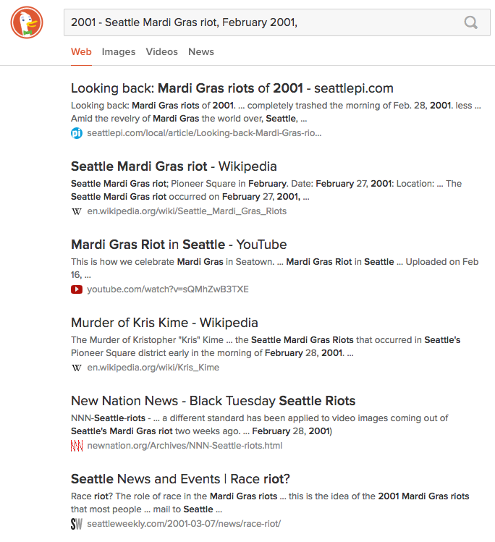
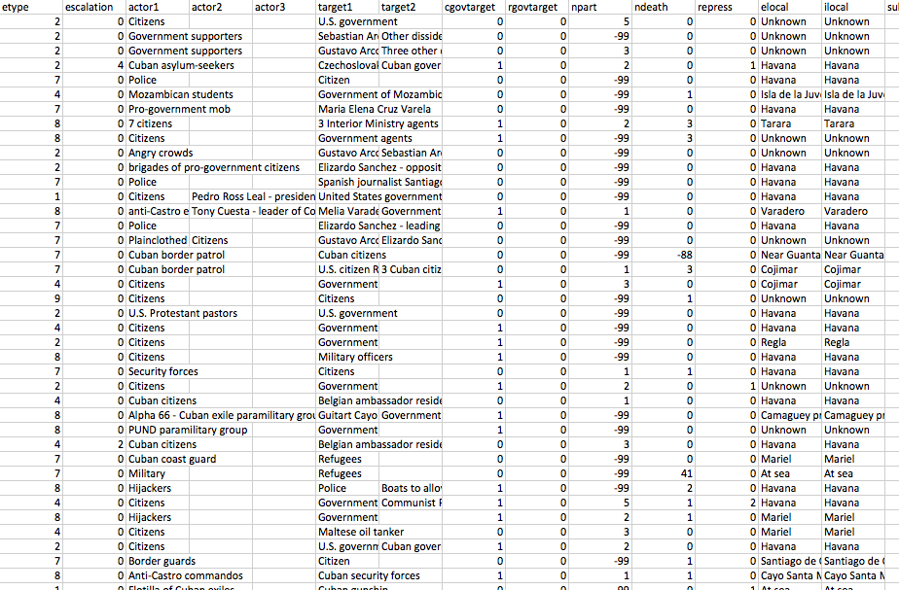
Data Collection
Unstructured Data
Structured Data
Social Conflict Analysis Database
Research team at the University of Texas at Austin

Slide 4
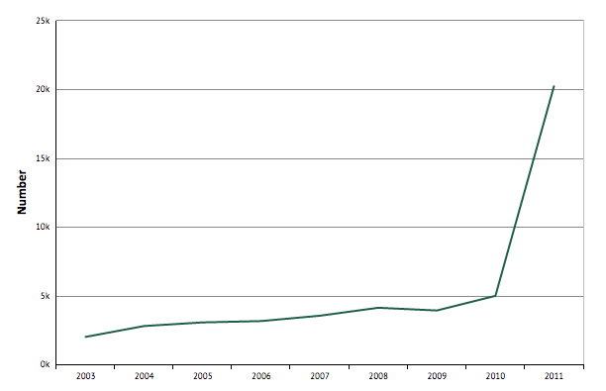
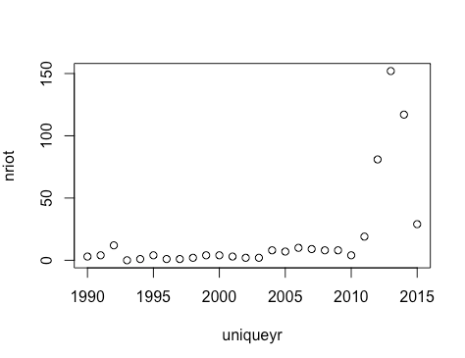
Extracting Information
Crime Rate
www.knoema.com
Homicides
Homicides by Firearms
Burglary, Car Theft, and Housebreaking
Assaults, Kidnapping, Robbery, and Sexual Rape
Ranges from 0.1 to 718.3

Slide 5
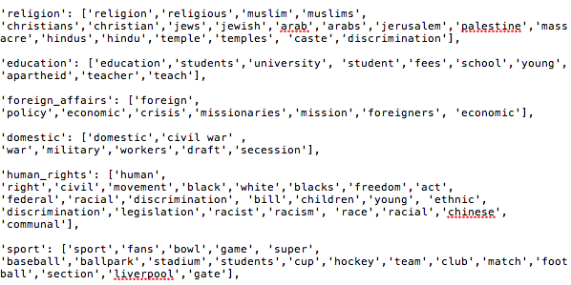
Extracting Information
Issue
Election
Jobs
Food
Environment Degradation
Ethnic Discrimination
Religion
Education
Foreign Affairs
Violence
Human Rights
Sport

Slide 6
Extracting Information
Target
Opposition Supporters (Citizens)
Government
Police
Corporations
Religious Group
Fans
Military
Tourist

Slide 7
Extracting Information
Number of Deaths
Number of Participants
Less than 10
10 – 100
101 – 1,000
1,001 - 10,000
10,001 – 100,000
100,001 – 1,000,000
Over 1,000,000

Slide 8


Extracting Information
Violence Rating

Slide 9
Machine Learning
Logistic Regression
Naïve Bayes
69% - 73% accuracy
Random Forest
Neural Network

